Slide 1
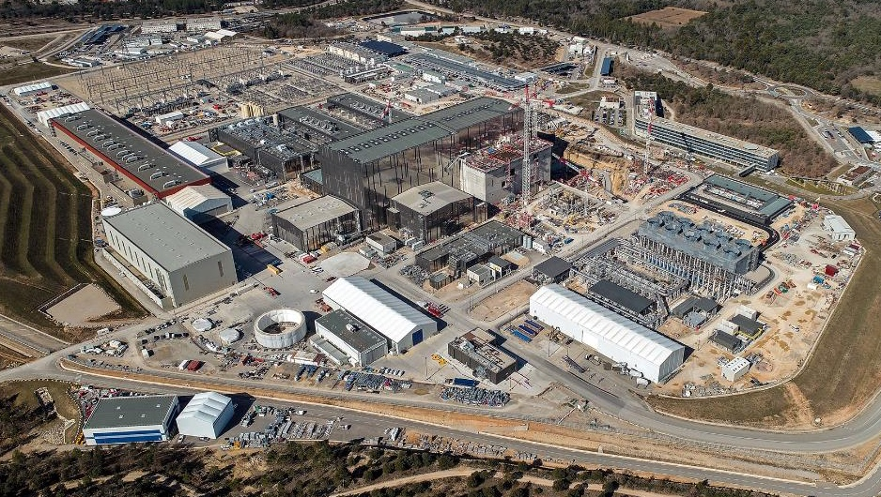

Bringing state of the art diagnostics
to a nuclear machine
M.F.M. De Bock
On behalf of the ITER Diagnostics Program
and with the support of many diagnostic teams all around the globe
The views and opinions expressed herein do not necessarily reflect those of the ITER Organization.
© 2024, ITER Organization

Slide 2
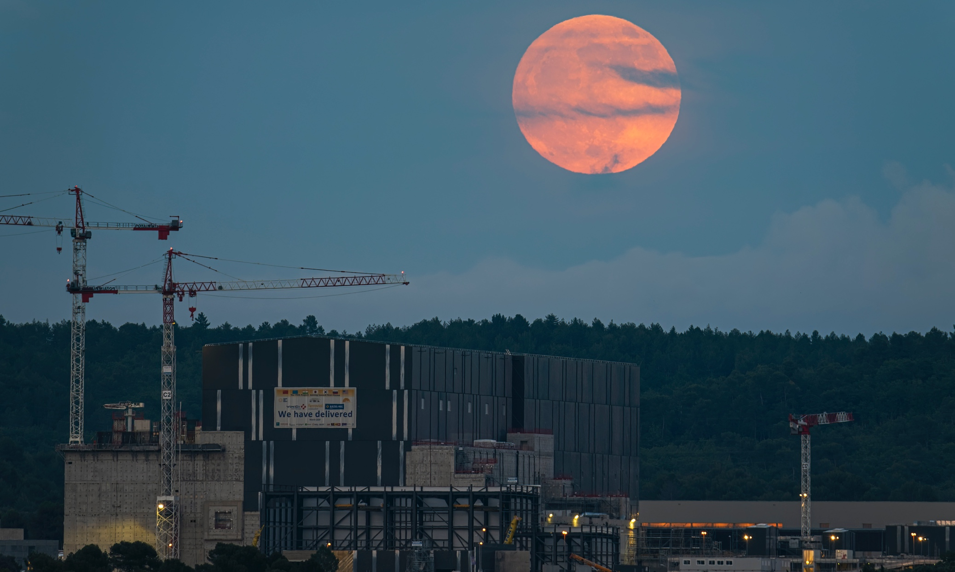
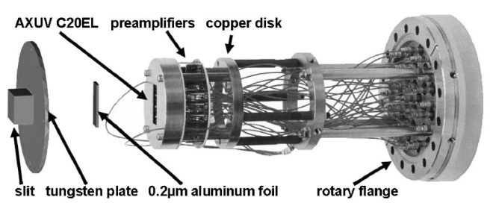
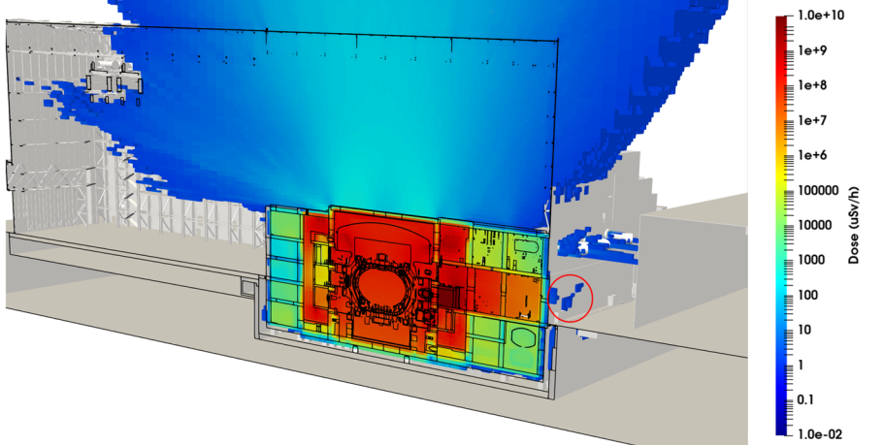
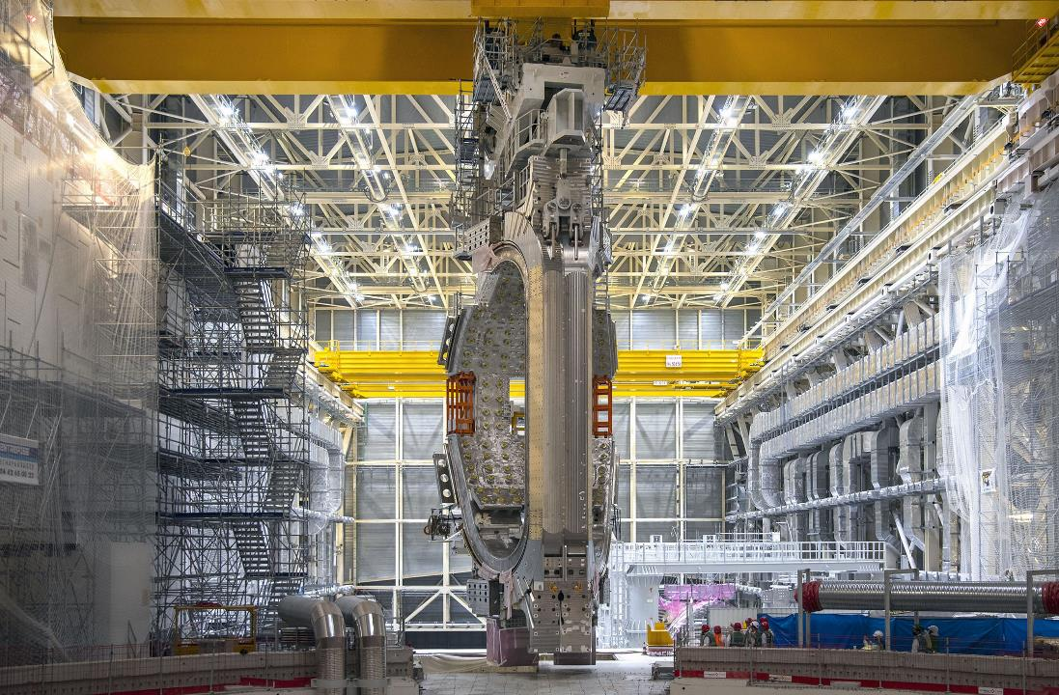
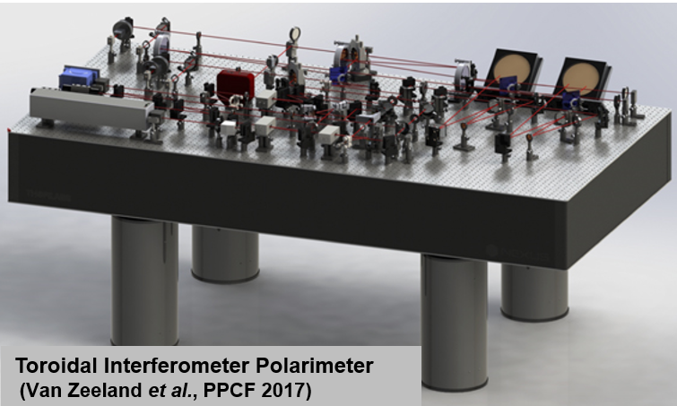
Content
Multichannel NPA (LHD)
(E. Veshchev et al., RSI 2006)
Status of the ITER project
Challenges of bringing state-of-the-art diagnostics …
To an INDUSTRIAL & NUCLEAR environment

Slide 3
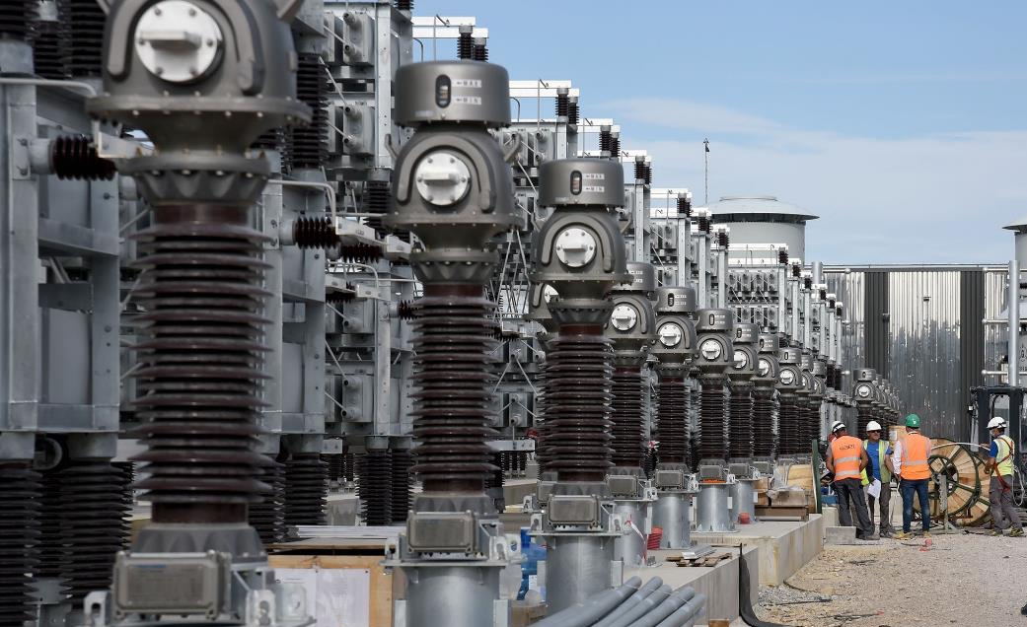
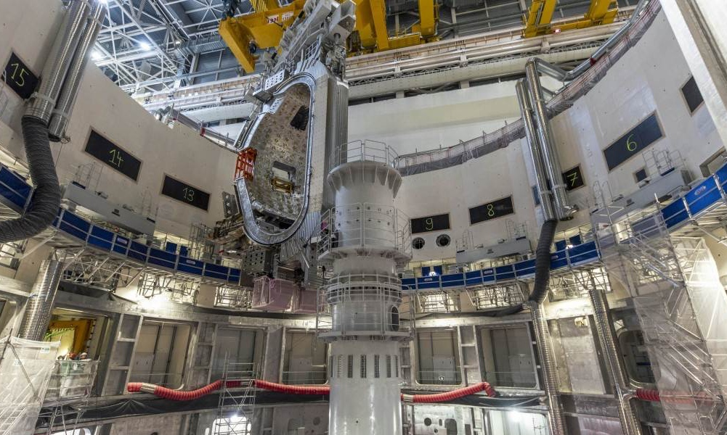
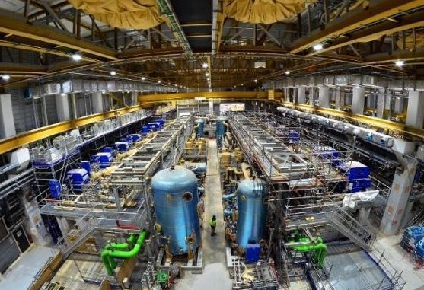
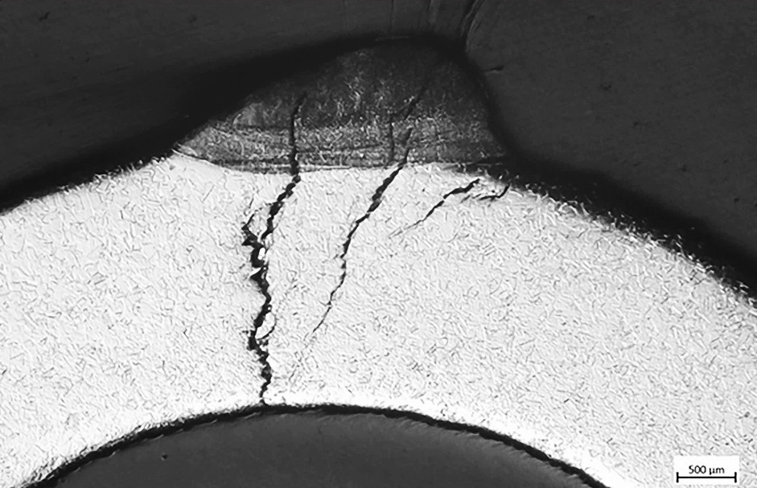
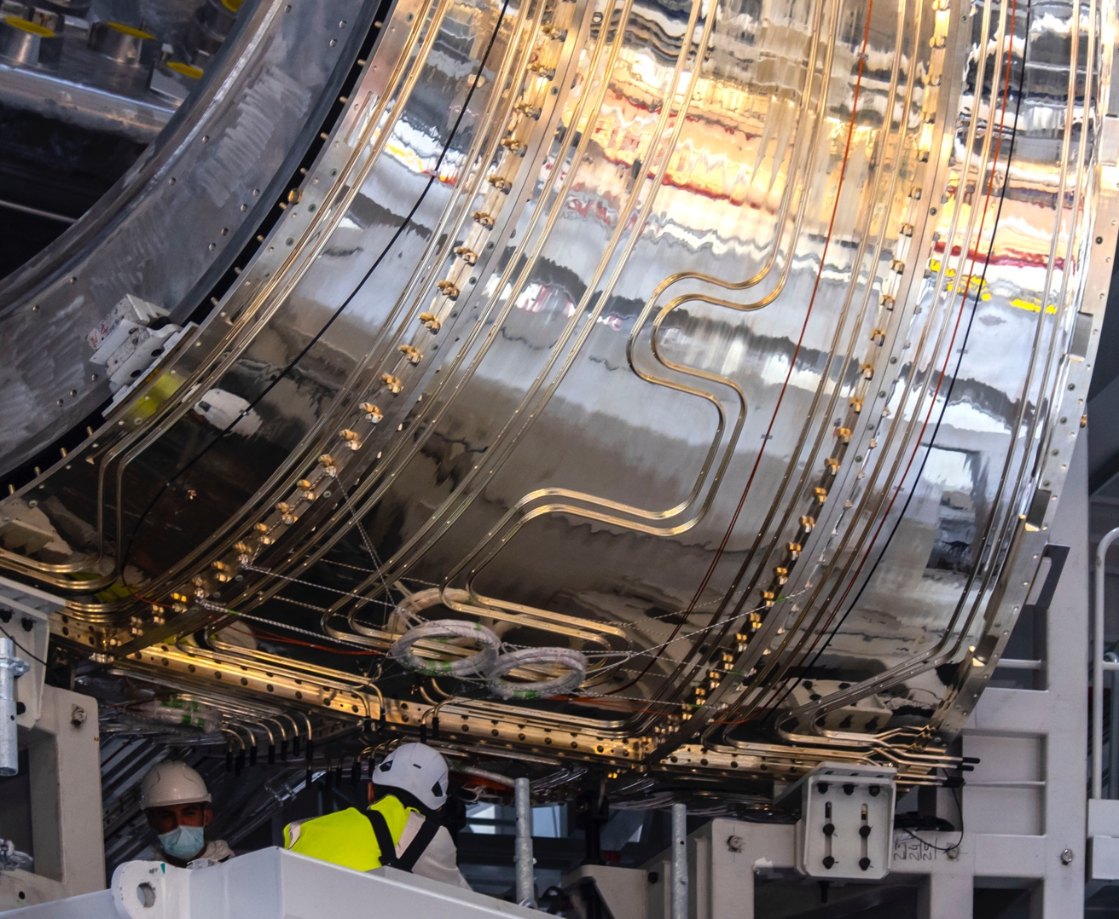
Status of the ITER project - Overall
Design and manufacturing of main components (Buildings, Cryoplant, Vacuum Vesssel, Magnets) finished or nearing finalization
Construction and assembly as no.1 activity
Challenge of 1st-of-a-kind components:
➔Some repair work on Nonconformaties
Power conversion
Thermal shield corrosion damage in repair
First complete Vacuum Vessel Sector Module lifted (May 2022)
Cryogenic plant

Slide 4
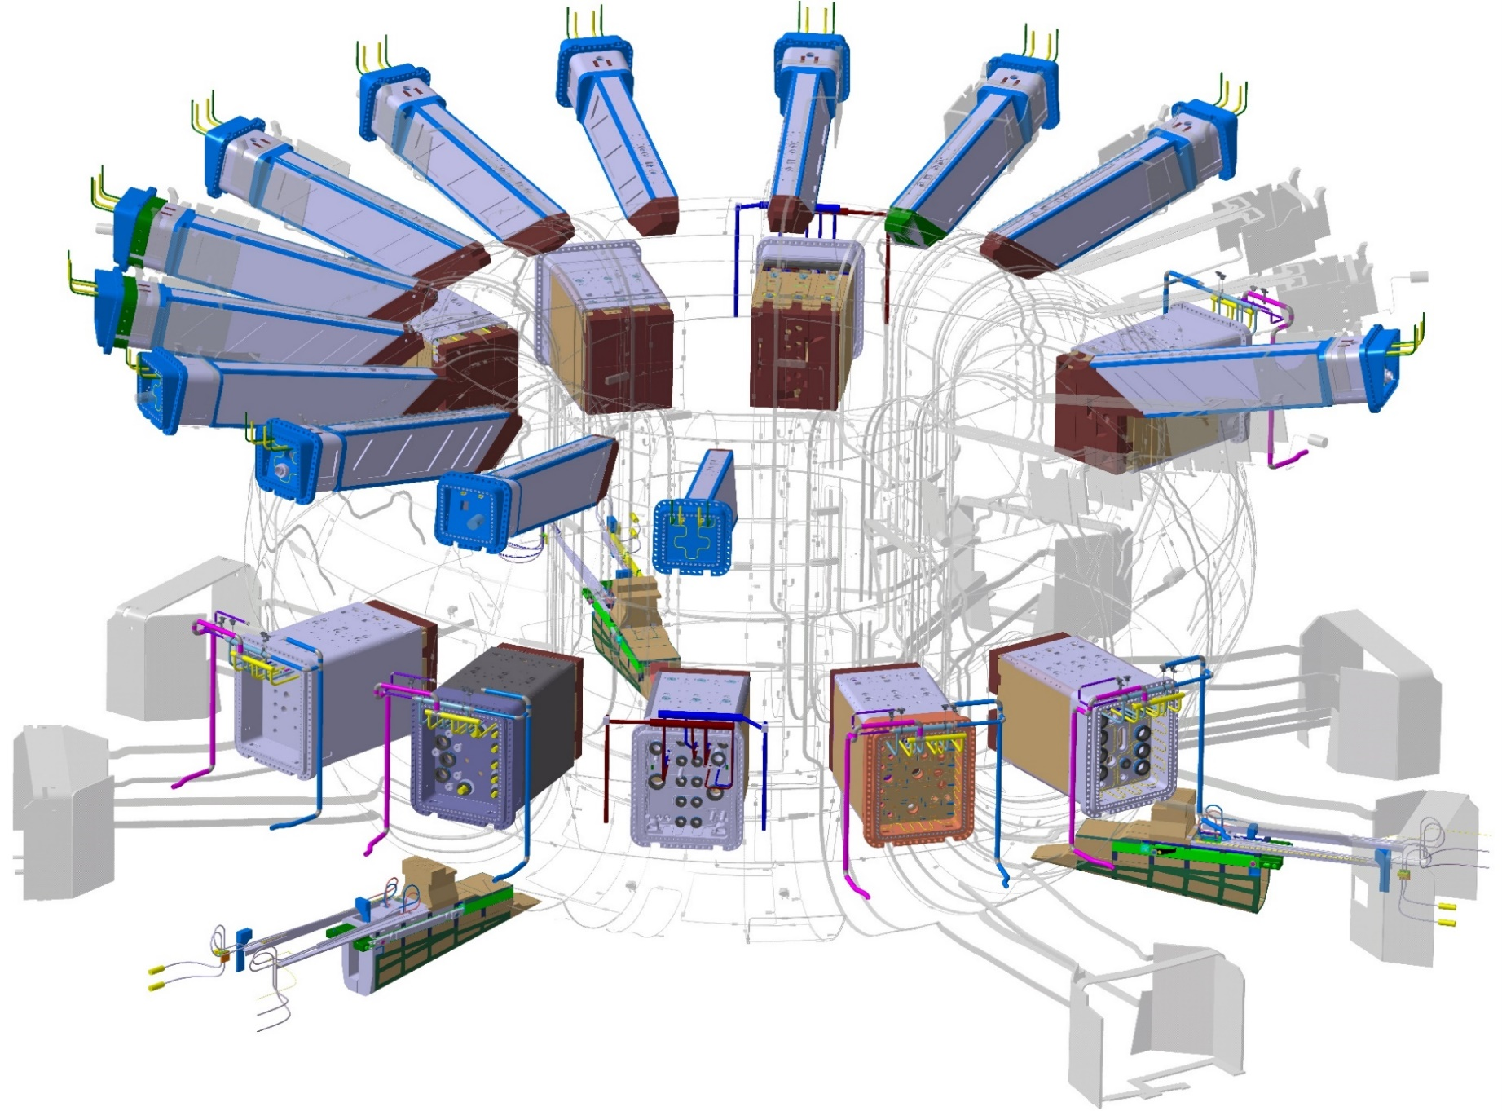
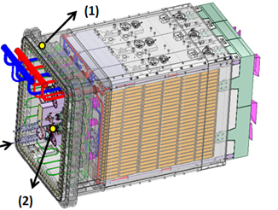
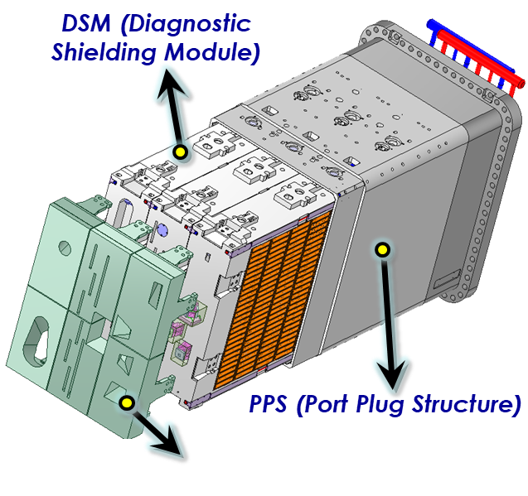
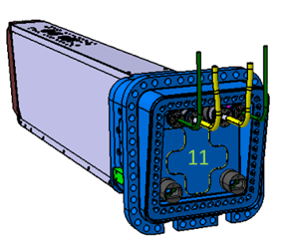
Status of the ITER Project - Diagnostics
About 50 diagnostics all around the machine
Example of modular integration in equatorial port
About 50 diagnostics all around the machine
Most in design,
but some manufactured &installed
100+ plasma parameters for
  Investment Protection, Plasma control
  and Physics studies
2
1
3
18
4
17
5
6
2
1
7
3
17
14
8
9
2
10
8
9
12
10
11
14
8
Equatorial port plug
(“plugs” the vacuum vessel)
DFW (Diagnostic First Wall)

Slide 5
Status of the ITER Project - Diagnostics
About 50 diagnostics all around the machine
Example of modular integration in equatorial port
Vacuum boundary
Concrete bioshield 1
Concrete bioshield 2 (with port cell door)
Equatorial port plug
(“plugs” the vacuum vessel)
Interspace
(between vacuum and 1st bioshield)
Port Cell Area
(between 1st and 2nd bioshield)

Slide 6
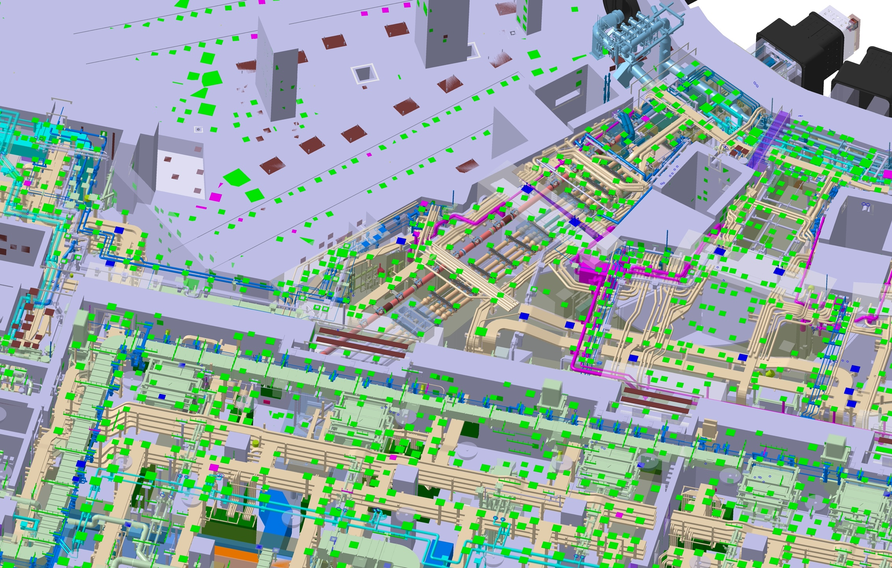
Status of the ITER Project - Diagnostics
About 50 diagnostics all around the machine
Example om modular integration in equatorial port
… and then you transport (waveguide, fibre, cables …) the signals to the diagnostic hall
Port Plug
ISS
PCSS
Bioshield walls
1, 2 and 3
Diagnostic building

Slide 7
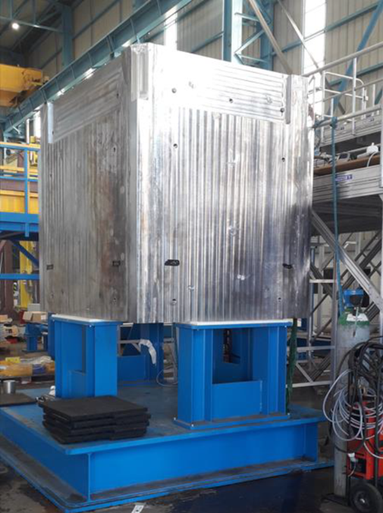
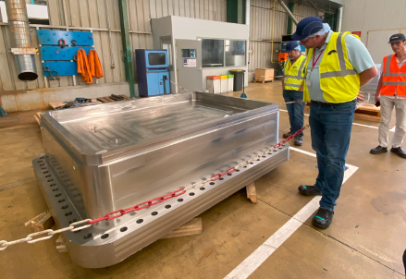
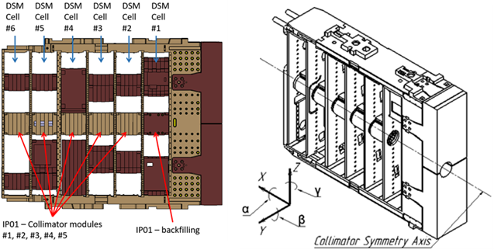
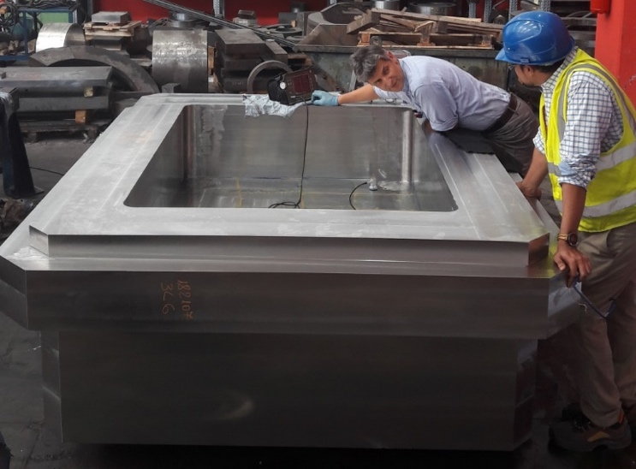
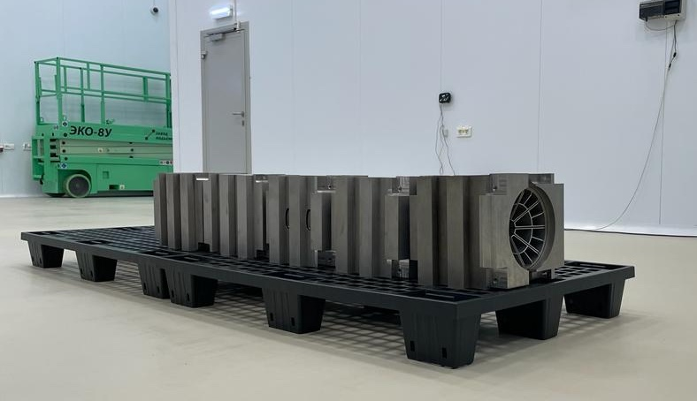
Status of the ITER Project
Examples of diagnostic components already manufactured
The big and heavy …
Port plug Manufacturing
Port Plug Test Facility (PPTF) vacuum tank
55.E8 NPA collimator
Multi-ton weight, multi-m³ volume, but accurately machined to sub-millimeter tolerances.
Built to reproduce the same vacuum and temperature conditions like in the Vacuum Vessel of the tokamak (10⁻⁵ Pa and thermal cycling between 20°C and 240°C at +5/-7°C/h).
Segmented with Tungsten blades to limit neutron streaming
and split in multiple pieces to enable DSM integration.

Slide 8
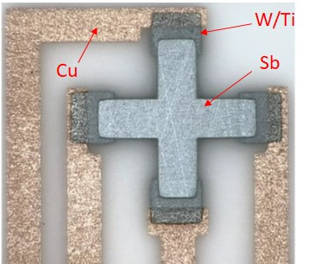
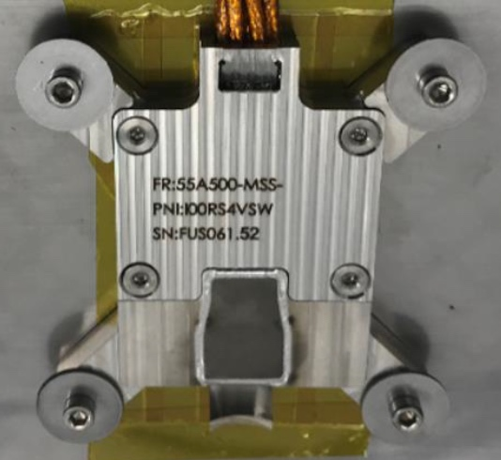
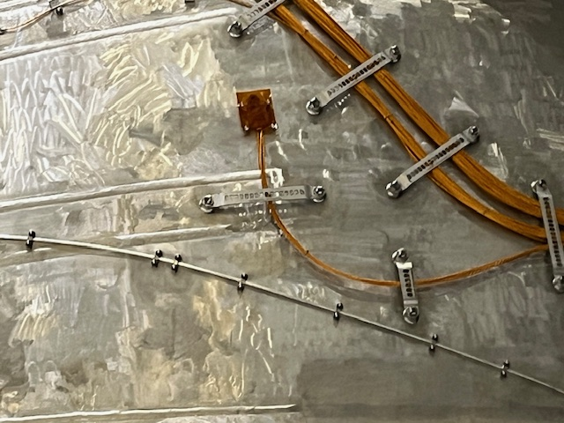
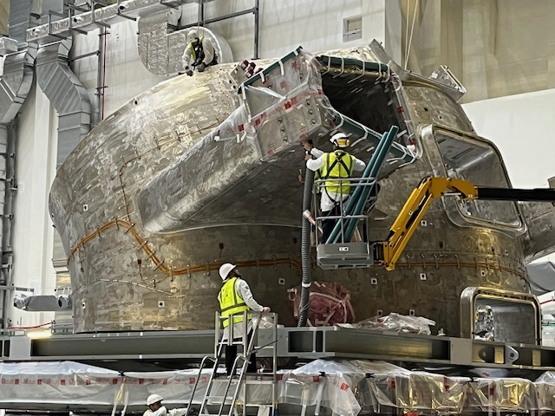
Status of the ITER Project
Examples of diagnostic components already manufactured
The tiny …
Steady State Hall sensors
2 radhard hall sensors with thermocouples and an Indium “bath” for temperature calibration

Slide 9
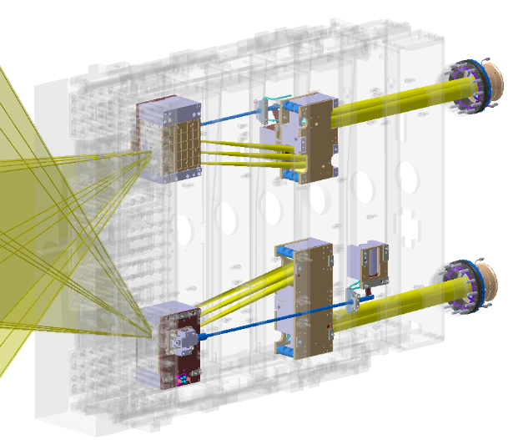
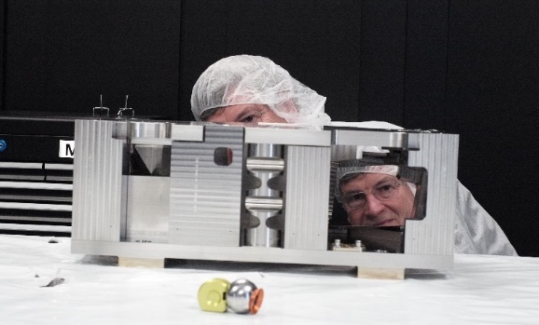
Status of the ITER Project
Examples of diagnostic components already manufactured
The shiny …
H-alpha in-vessel mirror units
“dogleg” unit: 2 mirrors forming a periscope-like deviation of the light such that the light can get out of the port plug, but the neutrons are optimally shielded

Slide 10
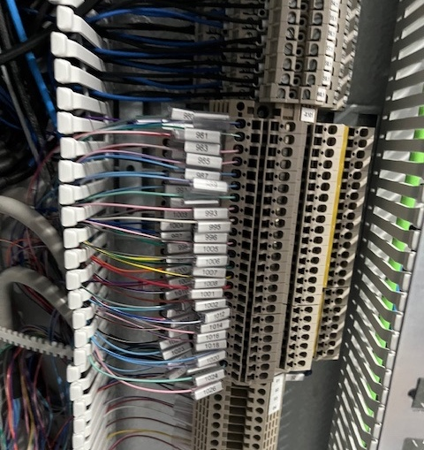
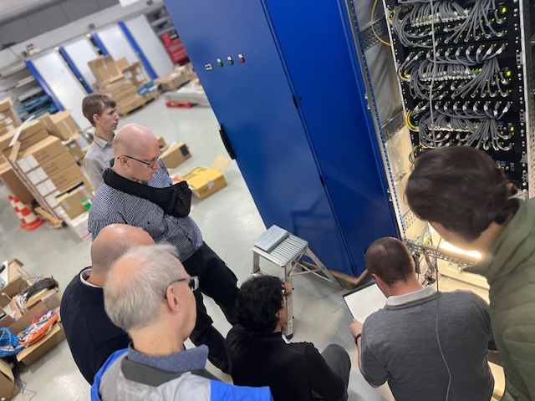
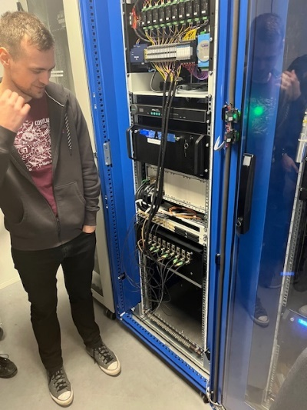
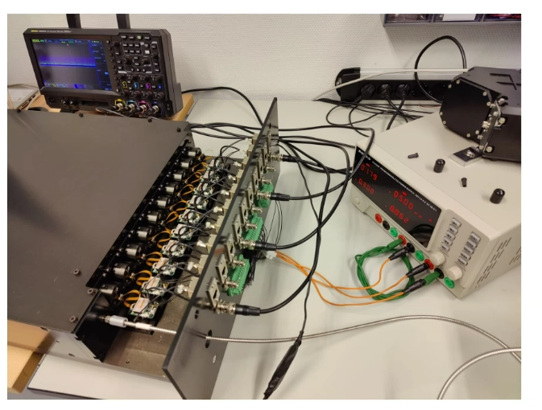
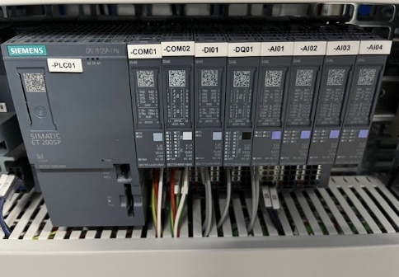
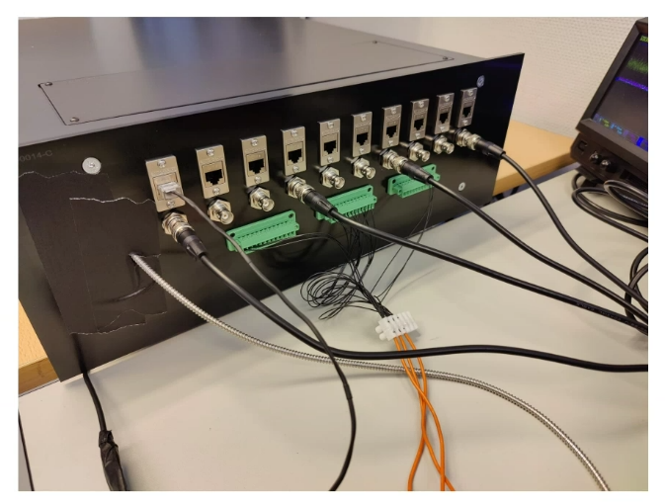
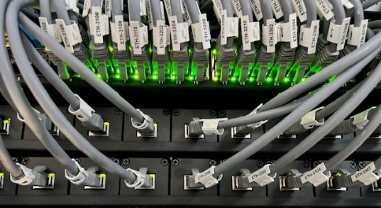
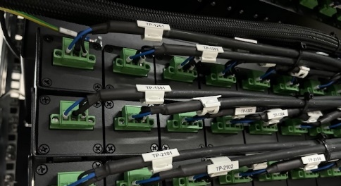
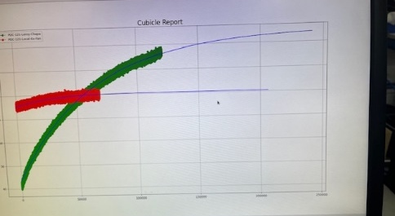
Status of the ITER Project
Examples of diagnostic components already manufactured
The (opto-)electronic …
Polychromator and control cubicle
10-channel filter-based spectrometer for Bremsstrahlung and strong line radiation
Magnetics at Factory Acceptance Testing
Including custom long pulse integrators

Slide 11
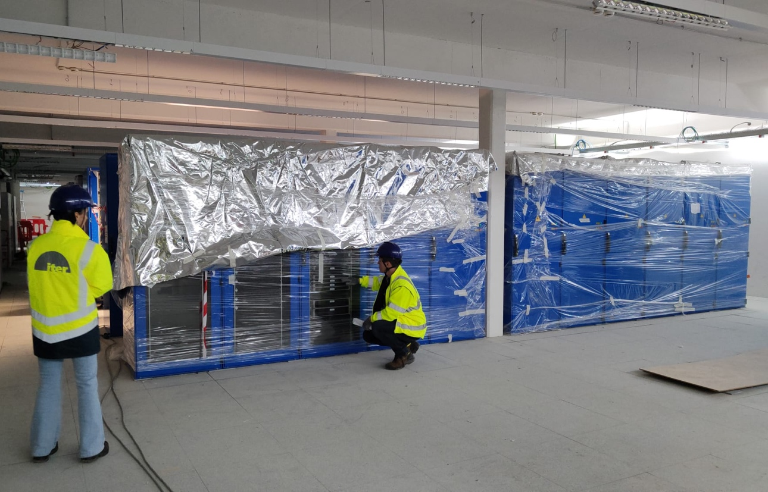
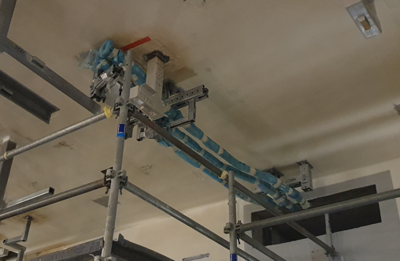
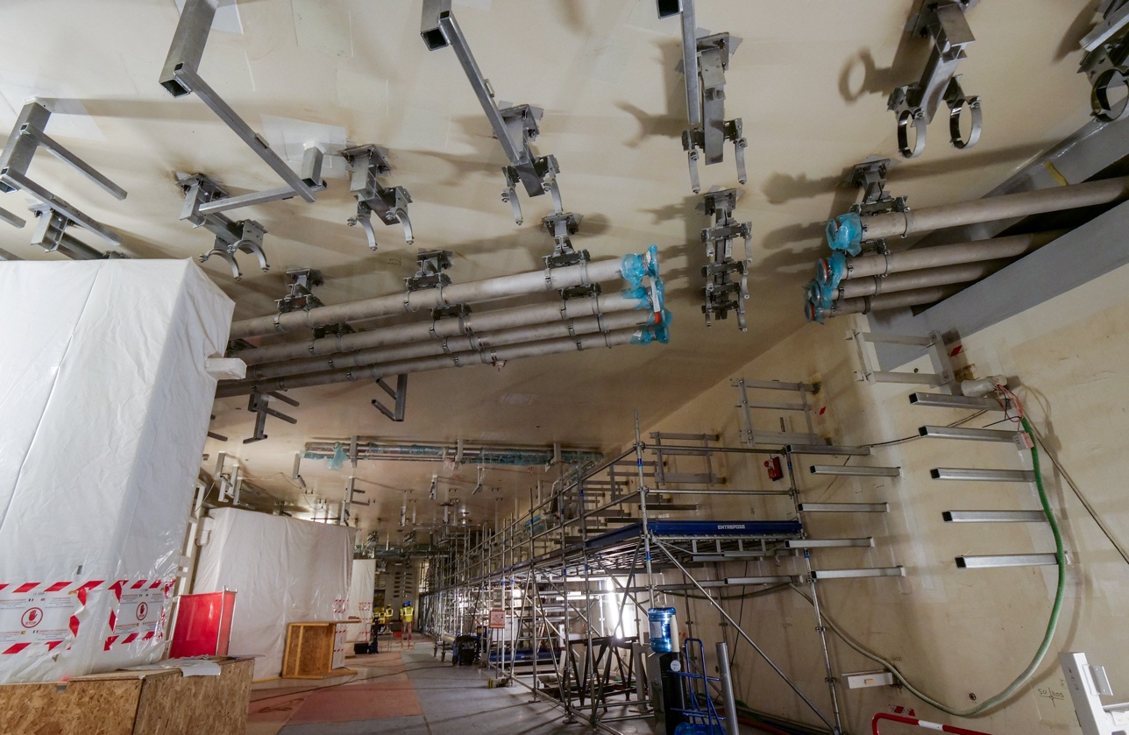
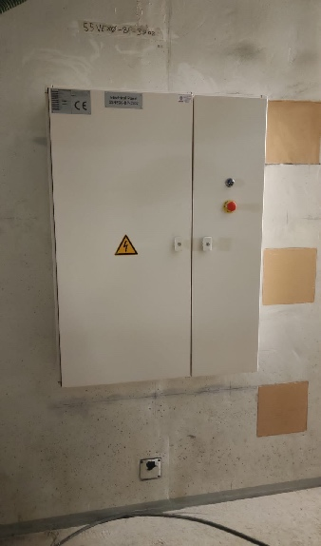
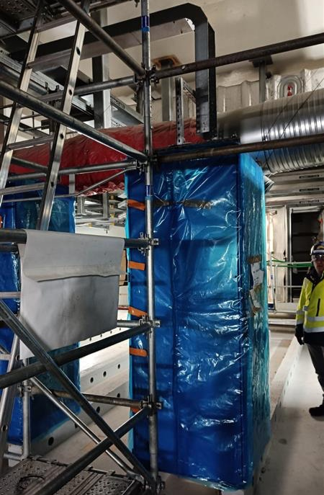
Status of the ITER Project
Examples of diagnostic components already manufactured
In the buildings …
“Captive” conduits and waveguides
For guiding fibre bundles and protecting laser light and microwaves.
“Captive” because cable trays, HVAC, sprinklers … will be installed below it
Wiring cubicles and power distribution boards
Distributing 10000+ cables to 50+ diagnostics and providing ~0.5MW of power

Slide 12
Status of the ITER Project - Diagnostics
Contributions on ITER diagnostics at this conference:
1.2.26 | Targeted Reflectivity Measurement at Specified Locations on SiC First Mirror for ITER divertor VUV spectrometer | Yoo Kwan | Kim | Korea Institute of Fusion Energy
1.2.29 | EUROfusion Diagnostic Enhancements, R&D and scientific exploitation in support of ITER research plan priorities | Joao | Figueiredo | EUROfusion
1.2.31 | Progress and challenges in the design of ITER's Polarimetric Thomson Scattering diagnostic system | Filippo | Bagnato | ITER Organization
1.2.41 | Measuring electron density with a OpGaAs based high-power IR dispersion interferometer | Vincent | Carrat | Bertin Technologies
1.4.13 | Design, Assembly and Test of a full-scale prototype In-Vessel Viewing System with hybrid LiDAR | Antoine | Bourgade | Bertin Technologies
1.4.16 | ECE Detection of Neoclassical Tearing Modes for Control for ITER | Joseph | Ziegel | Inst. for Fusion Studies, Univ. of Texas at Austin
1.4.18 | Verification of life-time and mechanical load aspects for ITER diagnostic pressure gauges based on ZrC emitter | Hans | Meister | Max-Planck-Institute for Plasmaphysics
1.4.44 | Results from a Synthetic Model of the ITER XRCS-Core Diagnostic Based on High-Fidelity X-Ray Ray Tracing | Novimir | Pablant | Princeton Plasma Physics Laboratory
2.2.8 | Self-radiometric calibration solution for tokamak's optical diagnostics | David | Anthoine | Bertin Technologies
2.2.13 | Development of a measuring technique based on JET DTE2 experience for assessing fusion power at ITER during DT operation using the radial gamma-ray spectrometer | Giulia | Marcer | University of Milano-Bicocca
2.2.20 | Performance Validation of the ITER XRCS-Core using Prototype Laboratory Tests | Lan | Gao | Princeton Plasma Physics Laboratory
3.2.39 | Novel Calibration Approach for the ITER Collective Thomson Scattering Diagnostic | Søren Bang | Korsholm | DTU Physics, Technical University of Denmark
3.4.3 | Long-term radiation impact on the ITER DRGA quadrupole mass spectrometer and degradation of plasma cell optical signal | Brendan | Quinlan | Oak Ridge National Laboratory
3.4.5 | The CXSFIT spectral fitting code: past, present and future | Ephrem | Delabie | Oak Ridge National Laboratory
3.4.35 | Designing ITER Motional Stark Effect Line Shift (MSE-LS) Spectrometers | Ilker | Uzun-Kaymak | Nova Photonics Inc.
4.2.16 | The Motional Stark Effect Diagnostic for ITER | Elizabeth | Foley | Nova Photonics, Inc.

Slide 13
Main challenges due to the ITER nuclear environment
ITER is first and foremost a Nuclear Facility (“Installation Nucléaire de Base (INB) 174”) …
… and only then an experimental science project
Technical challenges
  Transmutation, radiation damage and thermo-electric effects, heat loads, activation …
Safety and qualification challenges
  Protection Important Components (PIC): i.e. components with a nuclear confinement function like vacuum vessel feedthroughs and windows ➔ obviously very strict regulation
  Non-PIC: Still many extra requirements wrt non-nuclear installation (activation, shielding, access for alignment, calibration, maintenance …)

Slide 14
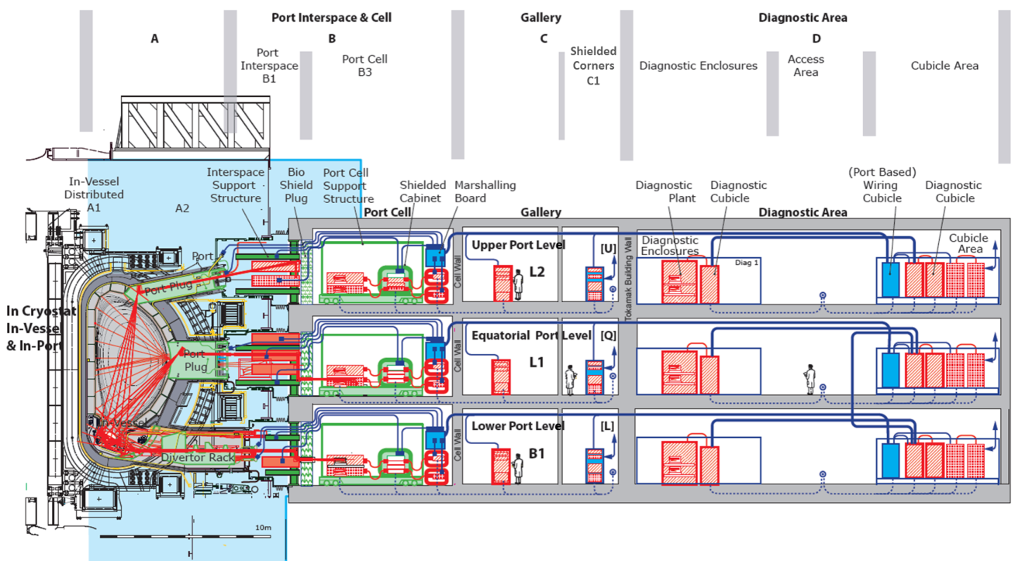
Technical challenges
Radiation and heat loads worst near the vacuum vessel and dropping off with distance and shielding
A: Transmutation, swelling, embrittlement some metals, high neutron and gamma heat loads
B: Radiation induced attenuation (RIA) of glass, embrittlement of polymers (cables), damage to all but the simplest electric/electronic components
C: Some RIA in glass (fibres), damage to unshielded COTS electronics (except in C1: shielded corners)
D: No radiation impact anymore. OK for COTS electronics and other instruments (Spectrometers, Lasers, Cameras, etc.)

Slide 15
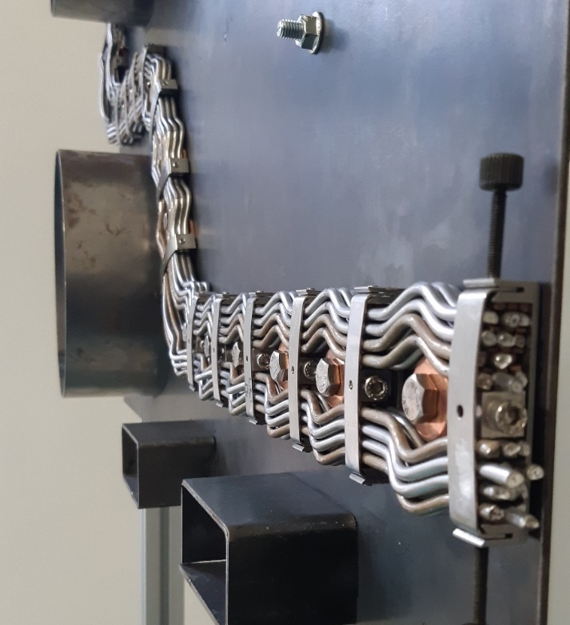
Technical challenges
Zone A: Inside the Vacuum vessel and Port plugs
  Very high radiation requires design ‘around’ shielding and severely limits material choices
  No polymers (not even Kapton, except on the very boundary), all metal and ceramics
Stainless steel and mineral insulated (e.g. SiO2) in-vessel cabling: very stiff and preformed loom installation

Slide 16
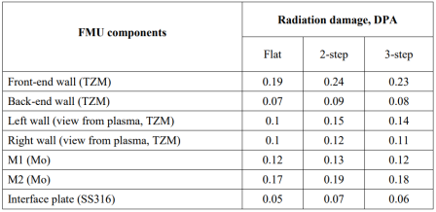
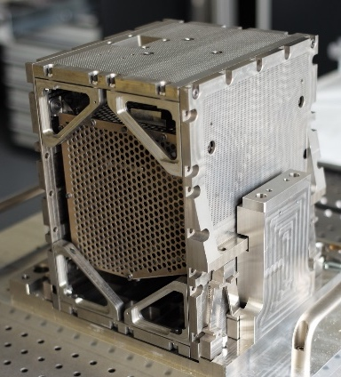
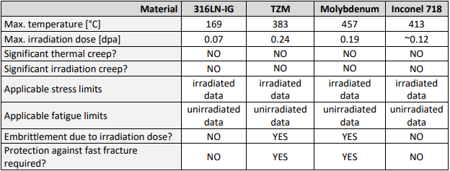
Technical challenges
Zone A: Inside the Vacuum vessel and Port plugs
  Very high radiation requires design ‘around’ shielding and severely limits material choices
  No polymers (not even Kapton, except on the boundary), all metal and ceramics
  Care to be taken wrt transmutation (e.g. Ag to Cd), swelling and embrittlement (e.g. Mo)
55.E2 H-alpha Front-Mirror Unit (FMU) with TZM, Mo, Stainless Steel and Inconel materials ⬄ Structural analysis took into account embrittlement

Slide 17
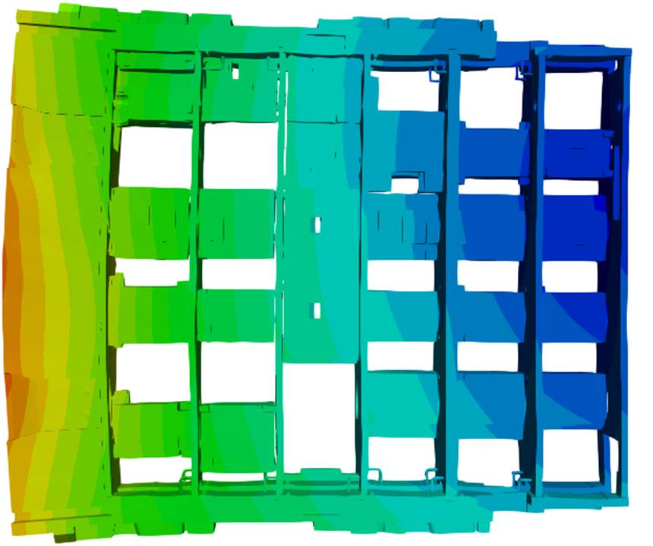
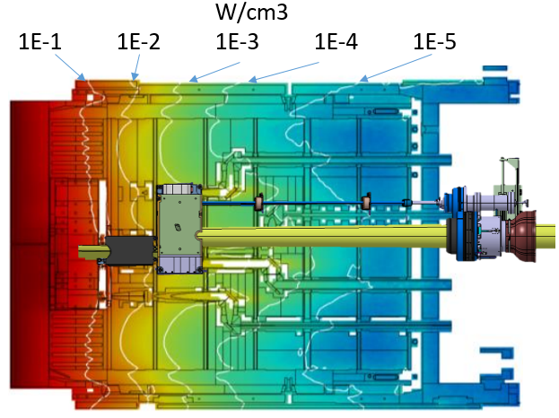
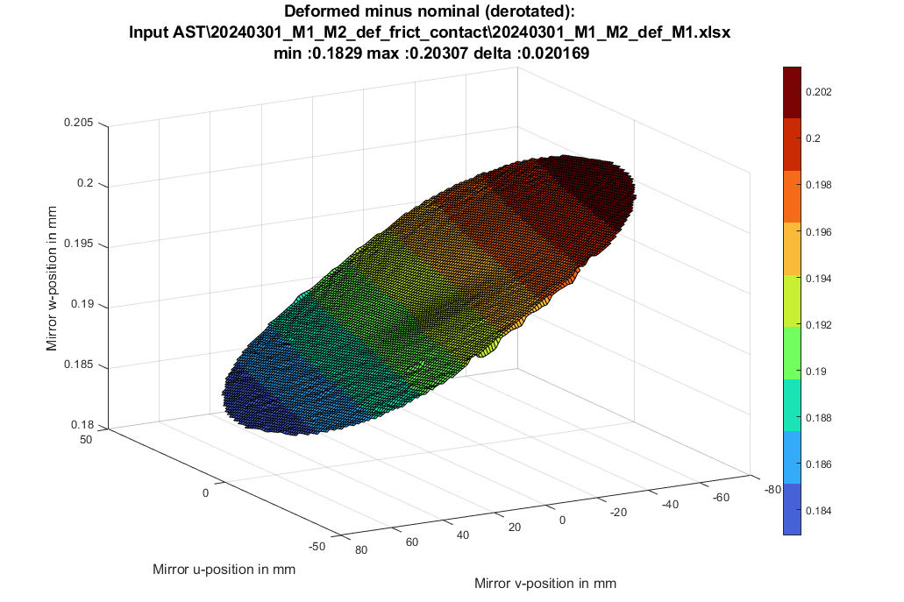
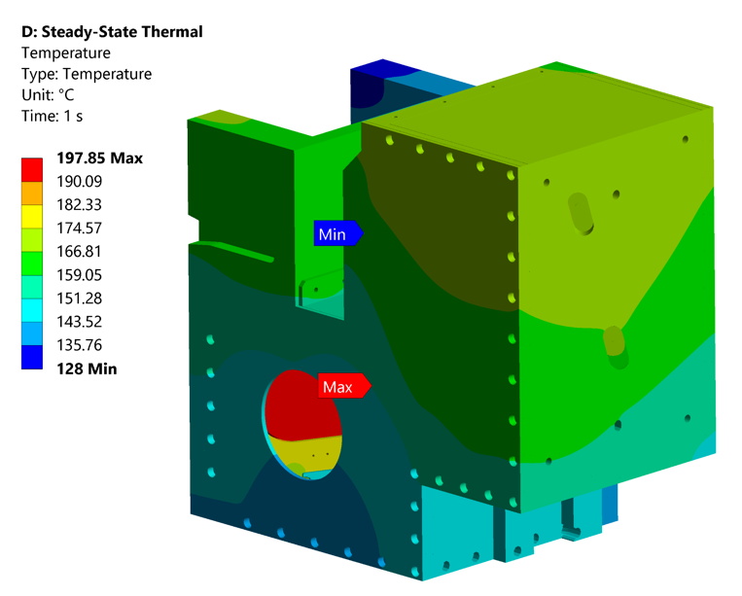

Technical challenges
Zone A: Inside the Vacuum vessel and Port plugs
  Very high radiation requires design ‘around’ shielding and severely limits material choices
  No polymers (not even Kapton, except on the boundary), all metal and ceramics
  Care to be taken wrt transmutation (e.g. Ag to Cd), swelling and embrittlement (e.g. Mo)
  Careful design to cope with thermal stresses and deformations …
    ➔ for Structural Integrity
    for thermal drifts in the measurements
Temperature gradient in port structure ⬄ deformation
Cut-out showing mirror itself
0.2 mrad mirror tilt and 550 nm dip
Equatorial port 8 heat load
Front Mirror Unit temperature gradients

Slide 18



Technical challenges
Zone A: Inside the Vacuum vessel and Port plugs
  Very high radiation requires design ‘around’ shielding and severely limits material choices
  No polymers (not even Kapton, except on the boundary), all metal and ceramics
  Care to be taken wrt transmutation (e.g. Ag to Cd), swelling and embrittlement (e.g. Mo)
  Careful design to cope with thermal stresses and deformations …
    ➔ for Structural Analysis
    for thermal drifts in the measurements
  …and often active water cooling needed for components
Diagnostic First Wall (DFW) cooling channel design and gun drilling qualification tests

Slide 19


Technical challenges
Zone A: Inside the Vacuum vessel and Port plugs
  Very high radiation requires design ‘around’ shielding and severely limits material choices
  No polymers (not even Kapton, except on the boundary), all metal and ceramics
  Care to be taken wrt transmutation (e.g. Ag to Cd), swelling and embrittlement (e.g. Mo)
  Careful design to cope with thermal stresses and deformations …
    ➔ for Structural Analysis
    for thermal drifts in the measurements
  …and often active water cooling needed for components
    ➔ Complicates (Remote handling) maintenance (cutting and rewelding cooling pipes)
RH pipe cutting-welding needs significant space

Slide 20

Technical challenges
Zone A: Inside the Vacuum vessel and Port plugs
  Very high radiation requires design ‘around’ shielding and severely limits material choices
  No polymers (not even Kapton, except on the boundary), all metal and ceramics
  Care to be taken wrt transmutation (e.g. Ag to Cd), swelling and embrittlement (e.g. Mo)
  Careful design to cope with thermal stresses and deformations …
    ➔ for Structural Analysis
    for thermal drifts in the measurements
  …and often active water cooling needed for components
    ➔ Complicates (Remote handling) maintenance (cutting and rewelding cooling pipes)
    Risk of cooling water leaks
Steam exposure tests on vacuum window
RH pipe cutting-welding needs significant space

Slide 21

Technical challenges
Zone B: Interspace and Port Cells
  Heat loads lower, but still reasonably high temperatures (up to 50 ˚C)
  Radiation levels too high for most polymers (except Kapton, PEEK, EPDM, PUR …)
  ⬄ special cables, o-rings etc. needed
  ⬄ Note: Teflon, PVC also not allowed (HCl and HF acids release in fire attacks detritiation system)
Coax cabling with Kapton insulation

Slide 22

Technical challenges
Zone B: Interspace and Port Cells
  Heat loads lower, but still reasonably high temperatures (up to 50 ˚C)
  Radiation levels too high for most polymers (except Kapton, PEEK, EPDM, PUR …)
  ⬄ special cables, o-rings etc. needed
  ⬄ Note: Teflon, PVC also not allowed (HCl and HF acids release in fire attacks detritiation system)
  Radiation levels high enough to induce attenuation of glass (RIA)
  ⬄ Affects vacuum windows, lenses, optical fibre
Glass samples before and after radiation

Slide 23

Technical challenges
Zone B: Interspace and Port Cells
  Heat loads lower, but still reasonably high temperatures (up to 50 ˚C)
  Radiation levels too high for most polymers (except Kapton, PEEK, EPDM, PUR …)
  ⬄ special cables, o-rings etc. needed
  ⬄ Note: Teflon, PVC also not allowed (HCl and HF acids release in fire attacks detritiation system)
  Radiation levels high enough to induce attenuation of glass (RIA)
  ⬄ Affects vacuum windows, lenses, optical fibre
  ⬄ Limits material choice, some recovery of fibres possible by heating to ~200-300 ˚C
100
Loss per neutron in 150m fibre
(dB/n x 10⁻²⁰)
10
RIA as function of annealing temperature
(A. T. Ramsey et al., RSI 68, 632 (1997))
Glass samples before and after radiation
Fibre temperature (˚C)

Slide 24

Technical challenges
Zone B: Interspace and Port Cells
  Heat loads lower, but still reasonably high temperatures (up to 50 ˚C)
  Radiation levels too high for most polymers (except Kapton, PEEK, EPDM, PUR …)
  ⬄ special cables, o-rings etc. needed
  ⬄ Note: Teflon, PVC also not allowed (HCl and HF acids release in fire attacks detritiation system)
  Radiation levels high enough to induce attenuation of glass (RIA)
  ⬄ Affects vacuum windows, lenses, optical fibre
  ⬄ Limits material choice, some recovery possible by heating to ~200 ˚C
  Radiation too high for all but simplest electr(on)ical components
  ⬄ Avoid all but a few radiation hard components (resistors, EM motors, Piezo actuators)
Before irradiation
After irradiation
Radiation testing of piezo actuators for the 55.G1 VisIR camera system
Runner ceramic cover color change

Slide 25



Technical challenges
Zone B: Interspace and Port Cells
  Heat loads lower, but still reasonably high temperatures (up to 50 C)
  Radiation levels too high for most polymers (except Kapton, PEEK, EPDM, PUR …)
  ⬄ special cables, o-rings etc. needed
  ⬄ Note: Teflon, PVC also not allowed (HCl and HF acids release in fire attacks detritiation system)
  Radiation levels high enough to induce attenuation of glass
  ⬄ Affects vacuum windows, lenses, optical fibre
  ⬄ Limits material choice, some recovery possible by heating to ~200 ˚C
  Radiation too high for all but simplest electr(on)ical components
  ⬄ Avoid all but a few radiation hard components (resistors, EM motors, Piezo actuators)
  ⬄ If no other option: design a shielded cabinet (big, heavy and complicated)
PORT PLUG
INTERSPACE
Stainless steel (gammas)
Iron (mag. field)
PORT CELL
B4C (neutrons)
Total thickness ~200-300 mm
Shielded cabinet for the 55.G1 VisIR cameras

Slide 26




Technical challenges
Zone C: Gallery and shielded corners
  More benign than port cells, but still significant radiation especially during cask transfer
  Shielded corners ok for most electronics, but remote and space limited
(C1)
Only simple Radhard components in port cell
Simple controllers/pre-amps in shielded corner
Complex I&C in Diagnostic Building
Diagnostics I&C (D)
Tokamak
(A)
~50m
Port cell (B)
Shielded corner
(C1)
~150m
Gallery (C)
(C1)

Slide 27



Safety and qualification challenges
Protection Important Components (PIC)
  E.g. Vacuum windows, electrical feedthroughs … but also e.g. waveguides crossing walls
  First function is SAFETY function:
    Need to have built-in redundancy: double windows, double valves, separated routing for cabling
    Need to be robust: Disruptions and Seismic events, Steam exposure, Thermal cycling, Radiation damage, ECH stray radiation, Fire … ➔ Prototype and final product testing
Vacuum window leak tightness test after 40 thermal cycles
Vacuum window steam exposure test
Electrical feedthrough prototype
Fibre bundle fire propagation test

Slide 28

Safety and qualification challenges
Protection Important Components (PIC)
  E.g. Vacuum windows, electrical feedthroughs … but also e.g. waveguides crossing walls
  First function is SAFETY function:
    Need to have built-in redundancy: double windows, double valves, separated routing for cabling
    Need to be robust: Disruptions and Seismic events, Steam exposure, Thermal cycling, Radiation damage, ECH stray radiation, Fire … ➔ Prototype and final product testing
  Compromising on functional performance might be needed:
    Reduced window transmission
    Limited number of electrical connections per cm² and/or current/voltage limitations
    Sealing between buildings/rooms: extra windows, valve, epoxy filled seals …
    Limitations on cross-section for vacuum extensions (e.g. signal throughput for VUV and X-ray systems)
Double safety bellows (for VV thermal expansion) setting minimum distance between vacuum extensions
Double safety valves limited to Ø160mm
55.E5 Core X-ray system

Slide 29

Safety and qualification challenges
Non Protection Important Components
  Although they have no safety function, they still are subject to overall safety requirements in nuclear environment
  Materials limitations for radwaste and shut down dose rate purposes
Impurity limitations:
<0.05% Co, <0.01% Ta, <0.01% Nb
Proven by EN 10204 3.1 Material Certificate
Deviation procedures to be followed if this requirement cannot be met.
➔ Testing, only low amount, no guarantee deviation will be accepted

Slide 30




Safety and qualification challenges
Non Protection Important Components
  Although they have no safety function, they still are subject to overall safety requirements in nuclear environment
  Materials limitations for radwaste and shut down dose rate purposes
  Exposure to maintenance workers shall be limited and ideally avoided. If really no other way:
    Protective suits
    Minimum access requirements
    Design to minimize maintenance/alignment/calibration needs and make maintenance/alignment/calibration as easy as possible of worker in protective clothing
Mock up of the closure plate of Equatorial Port #10 (EU DA)
Maintenance demonstration for Edge Thomson Scattering vacuum extension mock up

Slide 31






Safety and qualification challenges
How to minimize “human” maintenance/calibration/alignment
  Critical items: designed for Remote Handling replacement
  In-situ protection and recovery - shutters, mirror cleaning
  Redundancy where replacement is not possible (e.g. Magnetics in cryostat)
  In-situ calibration and alignment features
Magnetics redundancy
Making in-vessel sensors RH compatible
Pneumatic shutter tests
In-situ calibration mock-up
RF Mirror cleaning tests

Slide 32
Conclusions
Integration of diagnostics on a nuclear installation (like ITER) brings new challenges unprecedented in the current tokamaks
  Damage to equipment/materials one might be used to
  Much, much more effort for qualification … for PIC but also for non-PIC
  Front-end of diagnostics are almost ‘satellites’: once ‘launched’ hands-on maintenance is extremely complicated and rare
Most of these resolved with dedicated R&D and standardization and Moving forward thanks to teams within and outside ITER
Experience gained helps in carving a strong path for diagnostics in future nuclear fusion plants

Slide 33
Contributions on ITER diagnostics at this conference
1.2.26 | Targeted Reflectivity Measurement at Specified Locations on SiC First Mirror for ITER divertor VUV spectrometer | Yoo Kwan | Kim | Korea Institute of Fusion Energy
1.2.29 | EUROfusion Diagnostic Enhancements, R&D and scientific exploitation in support of ITER research plan priorities | Joao | Figueiredo | EUROfusion
1.2.31 | Progress and challenges in the design of ITER's Polarimetric Thomson Scattering diagnostic system | Filippo | Bagnato | ITER Organization
1.2.41 | Measuring electron density with a OpGaAs based high-power IR dispersion interferometer | Vincent | Carrat | Bertin Technologies
1.4.13 | Design, Assembly and Test of a full-scale prototype In-Vessel Viewing System with hybrid LiDAR | Antoine | Bourgade | Bertin Technologies
1.4.16 | ECE Detection of Neoclassical Tearing Modes for Control for ITER | Joseph | Ziegel | Inst. for Fusion Studies, Univ. of Texas at Austin
1.4.18 | Verification of life-time and mechanical load aspects for ITER diagnostic pressure gauges based on ZrC emitter | Hans | Meister | Max-Planck-Institute for Plasmaphysics
1.4.44 | Results from a Synthetic Model of the ITER XRCS-Core Diagnostic Based on High-Fidelity X-Ray Ray Tracing | Novimir | Pablant | Princeton Plasma Physics Laboratory
2.2.8 | Self-radiometric calibration solution for tokamak's optical diagnostics | David | Anthoine | Bertin Technologies
2.2.13 | Development of a measuring technique based on JET DTE2 experience for assessing fusion power at ITER during DT operation using the radial gamma-ray spectrometer | Giulia | Marcer | University of Milano-Bicocca
2.2.20 | Performance Validation of the ITER XRCS-Core using Prototype Laboratory Tests | Lan | Gao | Princeton Plasma Physics Laboratory
3.2.39 | Novel Calibration Approach for the ITER Collective Thomson Scattering Diagnostic | Søren Bang | Korsholm | DTU Physics, Technical University of Denmark
3.4.3 | Long-term radiation impact on the ITER DRGA quadrupole mass spectrometer and degradation of plasma cell optical signal | Brendan | Quinlan | Oak Ridge National Laboratory
3.4.5 | The CXSFIT spectral fitting code: past, present and future | Ephrem | Delabie | Oak Ridge National Laboratory
3.4.35 | Designing ITER Motional Stark Effect Line Shift (MSE-LS) Spectrometers | Ilker | Uzun-Kaymak | Nova Photonics Inc.
4.2.16 | The Motional Stark Effect Diagnostic for ITER | Elizabeth | Foley | Nova Photonics, Inc.

